Slide 1

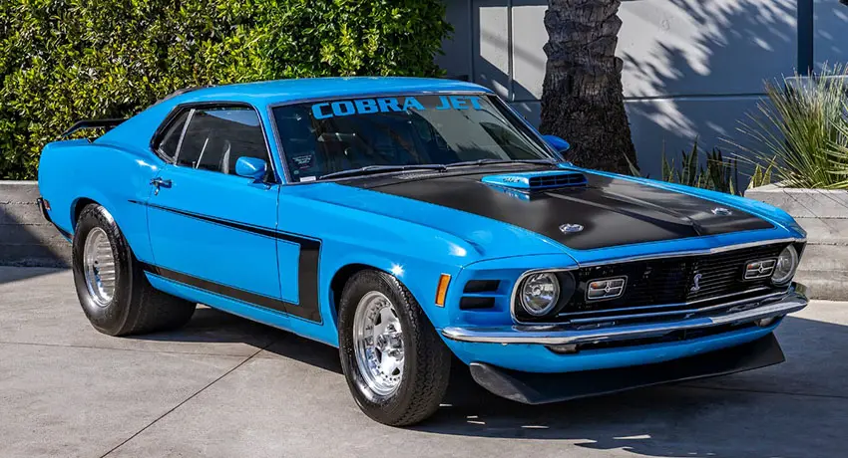

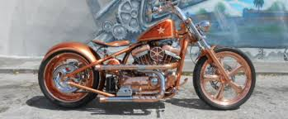
U.S. Military Vets Motorcycle Club Culpeper Chapter Car and
Motorcycle Show And Poker Run
25 April 2026
At
American Legion Post 330
14222 Rixeyville Rd
Poker Run $20.00 entry
$5.00 each Additional Card
Bike and Car Show Entry $10.00
Car and Motorcycle Show Start 1000
Judging starts at 1200
Poker Run 1st Bike out at 1000
Last Bike Out 1100
Best Hand
Worst Hand
Proceeds will benefit Veterans Causes
We Reserve the Right to Refuse Entry

