Slide 1
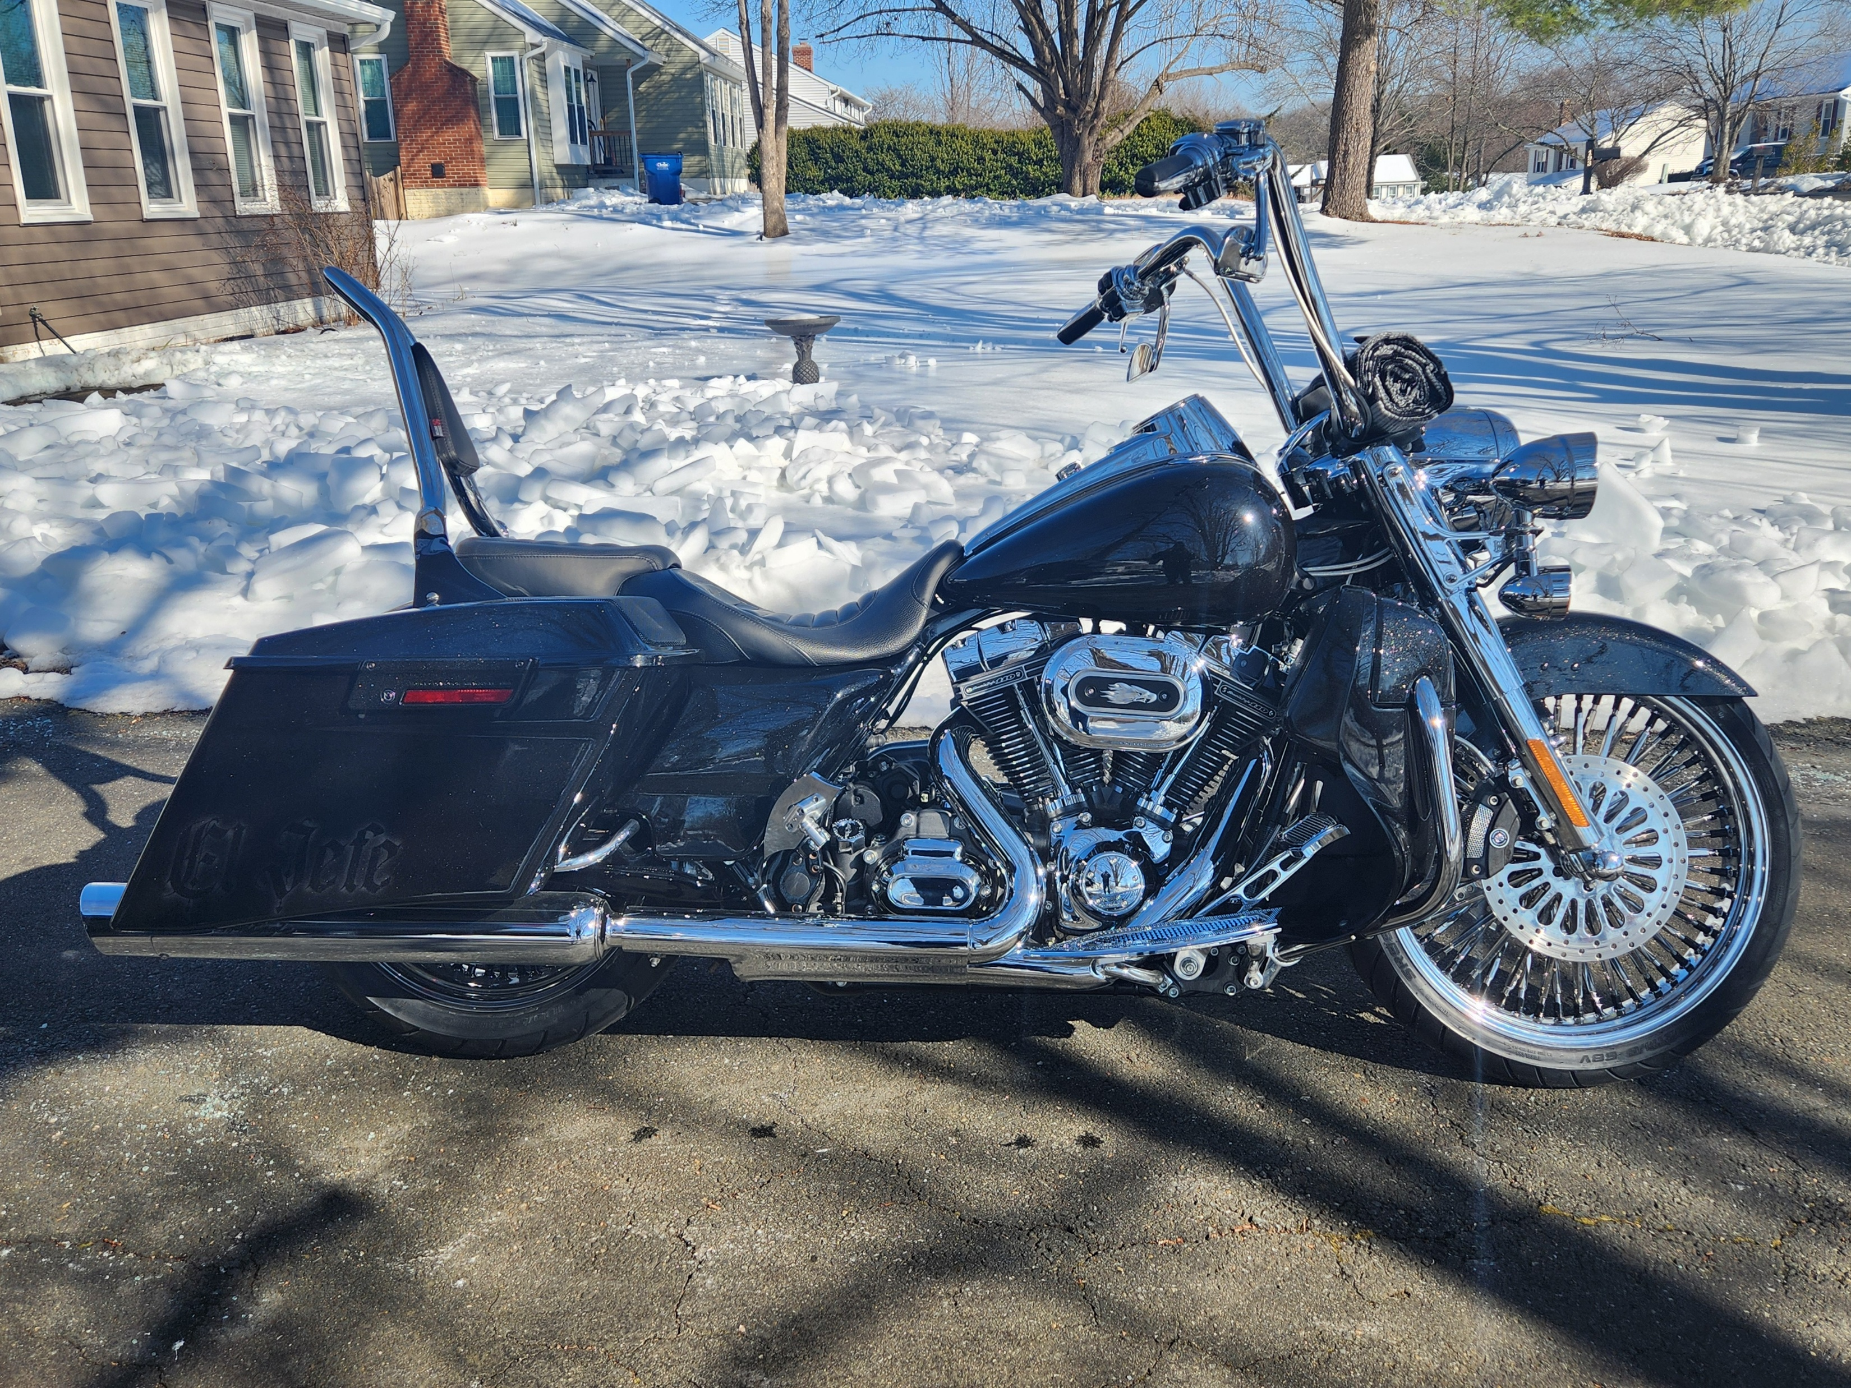

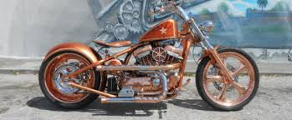
U.S. Military Vets Motorcycle Club
Culpeper VA
20 Year and Combined
Annual
At
American Legion Post 330
14222 Rixeyville Rd
Culpeper VA
26 – 28 June 2026
Entry $10.00
POC:
Rick “Gargoyle” Gonzales: 540-446-7159
Gerard “Scooter” Carlson: 267-980-6912
Primitive Camping
Hotels
Holiday Inn Express Hampton Inn
540-546-0261 540-298-6191
787 Madison Rd 18411 Gate Rd
Culpeper VA Culpeper Va
Meet and Greet Friday 26 June 1400 – 2359
Annual Saturday 27 June 1200 - 1800
Proceeds will benefit Veterans Causes
We Reserve the Right to Refuse Entry

